Slide 1
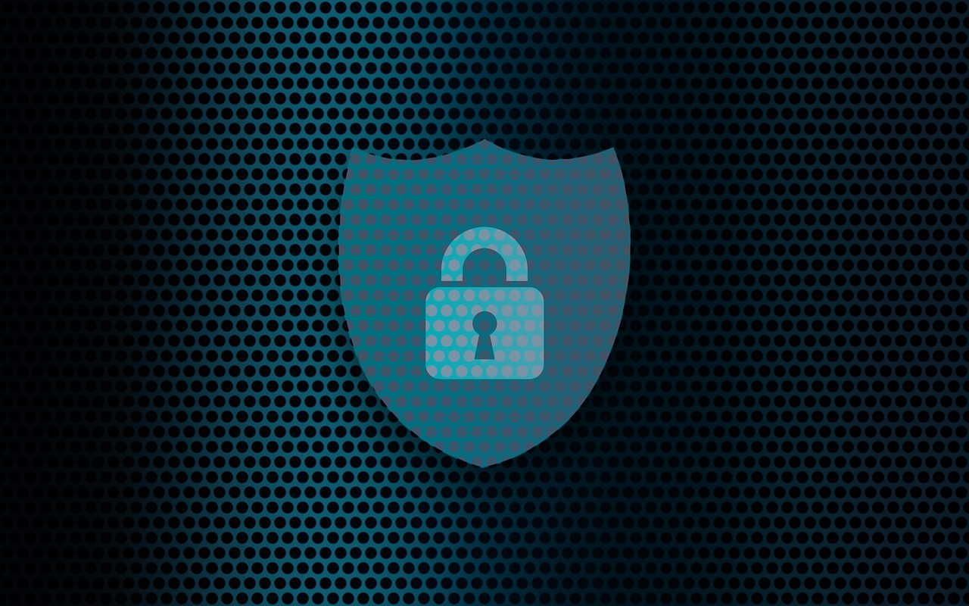
Wifi and Internet Security
By: Jonathan Kaufman
Christopher Newport University

Slide 2
Outline
Dangers of Using Public Wifi
How to Protect Yourself When Browsing
General Best Practices with using Wifi and Internet

Slide 3
Dangers of Using Public Wifi
Potentially a fake public Wifi Network setup by a hacker (Evil Twin Attack)
Hackers can sniff information being transmitted over the network
Can use this information to steal information and/or hack your accounts

Slide 4
Protecting Yourself on the Internet
Update Privacy settings on your browser
Do not give out personal information on untrusted sites
Be careful of the sites you go to and the software that you download

Slide 5
Best Practices of Using Wifi
Avoid using Public Wifi whenever possible
If you want to protect yourself even more, use a VPN
Be careful of the networks you connect to
Do not put in any personal information or use any sensitive sites such as banking when using public wifi

